Slide 1
Chapter 9
Multivariate Correlational Research

Slide 2
Agenda
Refresher
Longitudinal Designs
Multiple Regression
Mediators & Moderators
The Big Four Validities
Next time on PSY 270…

Slide 3
Multivariate Correlational Research
How many variables do you think are included in multivariate research?
Are those variables measured or manipulated?

Slide 4
So, why can’t bivariate correlational studies establish causation?

Slide 5
Problem 1: Temporal Precedence
Can’t establish temporal precedence -> Try including time?

Slide 6
Longitudinal Studies
Longitudinal research – Studies that measure the same variables over time
Cross-sectional research – Research that evaluates the same variables in two different groups of people at the same time
Longitudinal cross-sectional research – Research that evaluates the same variables in two different groups of people over time

Slide 7
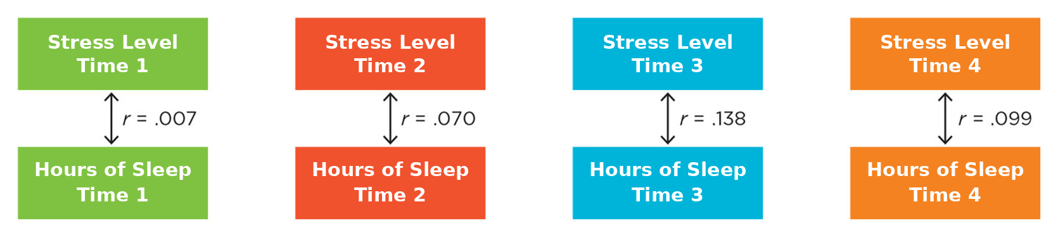
Cross-Sectional Correlations
Cross-sectional correlations – An analysis of the correlation between two variables at the same point in time

Slide 8
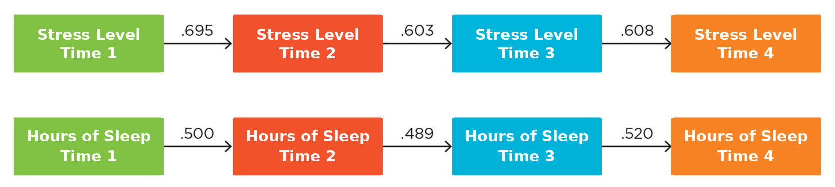
Autocorrelations
Autocorrelations – The correlation of one variable with itself, measured at multiple times

Slide 9
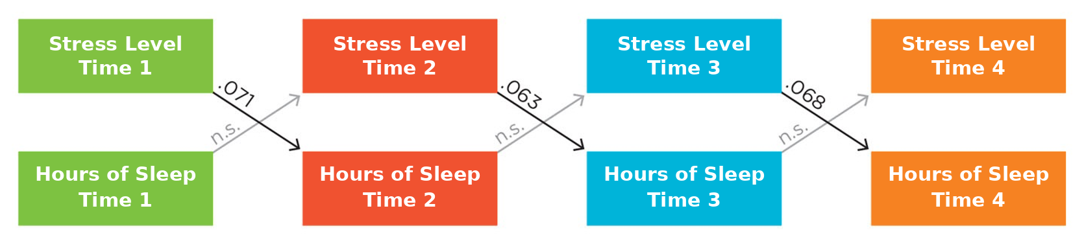
Cross-Lag Correlations
Cross-lag correlations – The correlation of one variable with a second variable at the following time point

Slide 10
Interpreting Cross-Lag Correlations
Variable A-Time 1 is correlated with Variable B-Time 2
  Ex: Stress-Time 1 is correlated with Sleep-Time 2
  Interpret: High stress may predict poor sleep
Variable B-Time 1 is correlated with Variable A-Time 2
  Ex: Sleep-Time 1 is correlated with Stress-Time 2
  Interpret: Poor sleep may predict higher stress
Variable A-Time 1 is correlated with Variable B-Time 2 AND Variable B-Time 1 is correlated with Variable A-Time 2
  Ex: Stress-Time 1 is correlated with Sleep-Time 2 AND Sleep-Time 1 is correlated with Stress-Time 2
  Interpret: Poor sleep and high stress are in a reinforcing cycle

Slide 11
Problem 1: Temporal Precedence
Have we established temporal precedence?

Slide 12
Problem 2: Internal Validity
Can’t rule out the third variable-> Try including more variables?

Slide 13
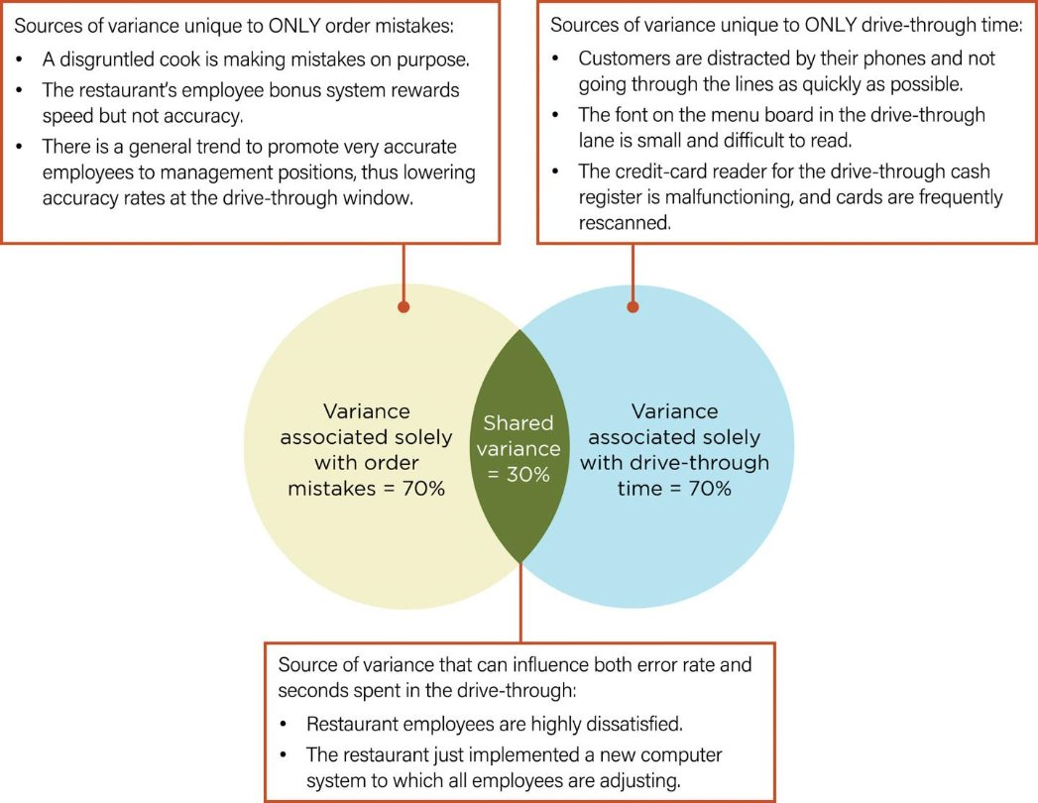
Regression
Correlation – the strength and direction of a relationship (r)
Linear regression – how well we can predict one variable with another variable (r²)
  r² = 0 → No shared variance (0%)​
  r² = 1 → Perfectly predicted variance (100%)
So, if r² = .80, then 80% of the variation in Y is explained by the variation in X
  General thresholds for strength of prediction:
  < 0.3 = weak
  0.3 – 0.7 = moderate
  0.7+ = strong

Slide 14
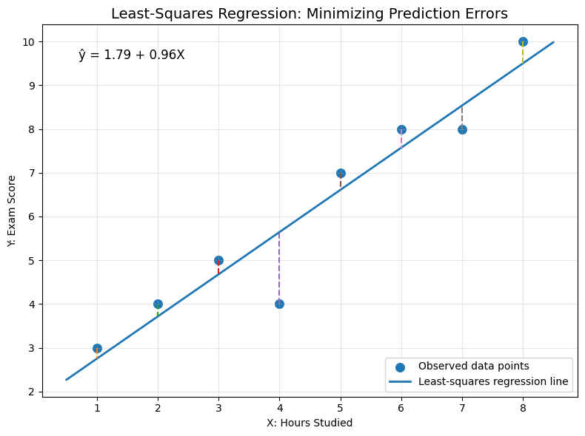
Regression
Regression is often also discussed as a line of best fit, trying to fit a line to the data that minimizes the difference between the actual values and the predicted values
  Y = a + bX
    X = predictor variable
    Y = outcome variable
    a = intercept
    b = slope for predictor variable

Slide 15
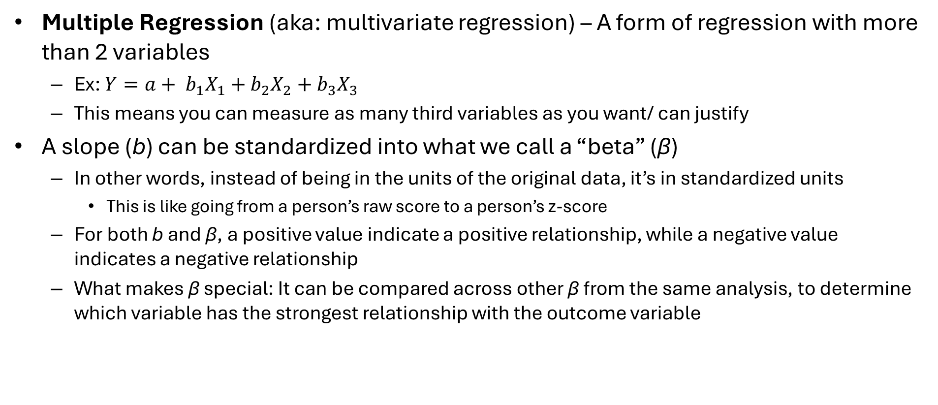
Multiple Regression
Multiple Regression (aka: multivariate regression) – A form of regression with more than 2 variables
  Ex: $Y=a+ b_{1}X_{1}+b_{2}X_{2}+b_{3}X_{3}$
  This means you can measure as many third variables as you want/ can justify
A slope (b) can be standardized into what we call a “beta” (β)
  In other words, instead of being in the units of the original data, it’s in standardized units
    This is like going from a person’s raw score to a person’s z-score
  For both b and β, a positive value indicate a positive relationship, while a negative value indicates a negative relationship
  What makes β special: It can be compared across other β from the same analysis, to determine which variable has the strongest relationship with the outcome variable

Slide 16
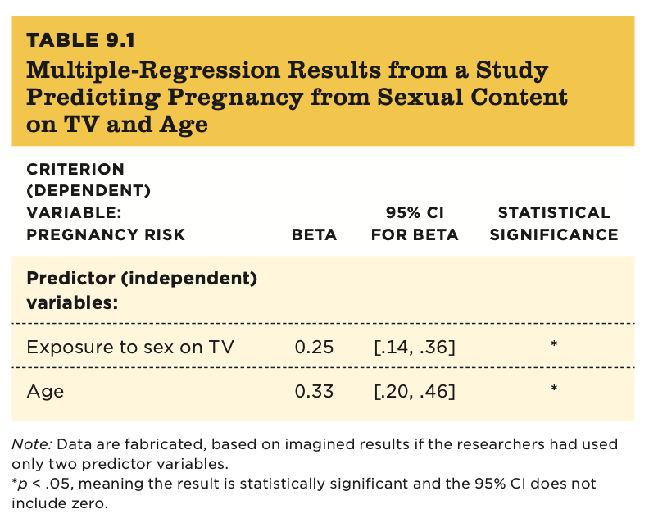
Interpreting Multiple Regression
The larger the beta, the stronger the relationship with the outcome variable
If the 95% CI does not include 0, then the relationship is significant
If the p-value is low enough (ex: < .05), then the relationship is significant
Ex: evaluating exposure to sex on TV, age, and teen pregnancy
  Can exposure to sex on TV predict teen pregnancy?
  Can age predict teen pregnancy?
  Which is the stronger predictor?

Slide 17
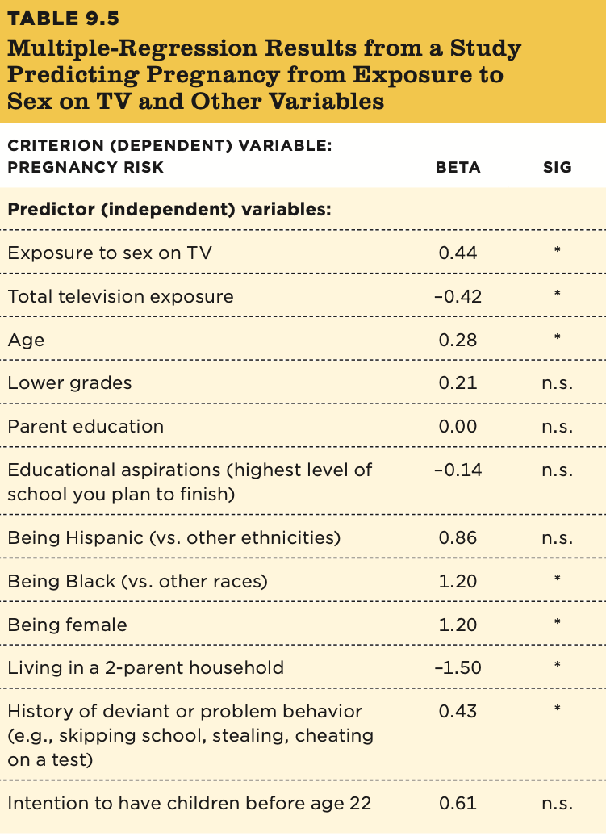
Interpreting Multiple Regression
When you add more variables, it adjusts the betas for all other variables
What is the relationship for each variable? Is it significant?

Slide 18
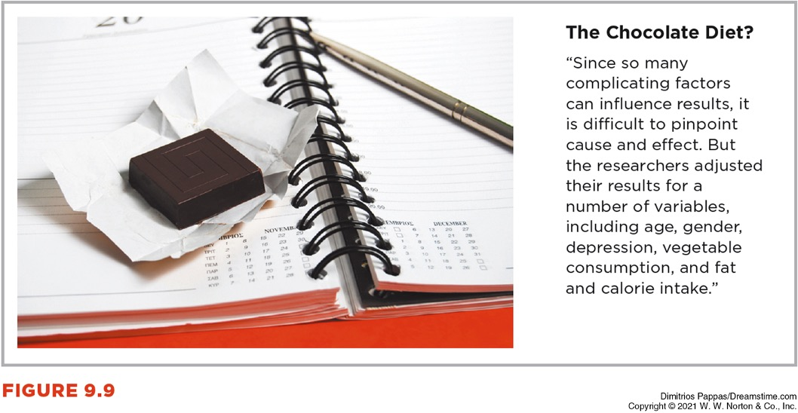
Multiple Regression in Media
Key words:
“Controlled for”
“Adjusting for”
“Considering

Slide 19
Problem 2: Internal Validity
Have we established internal validity?

Slide 20
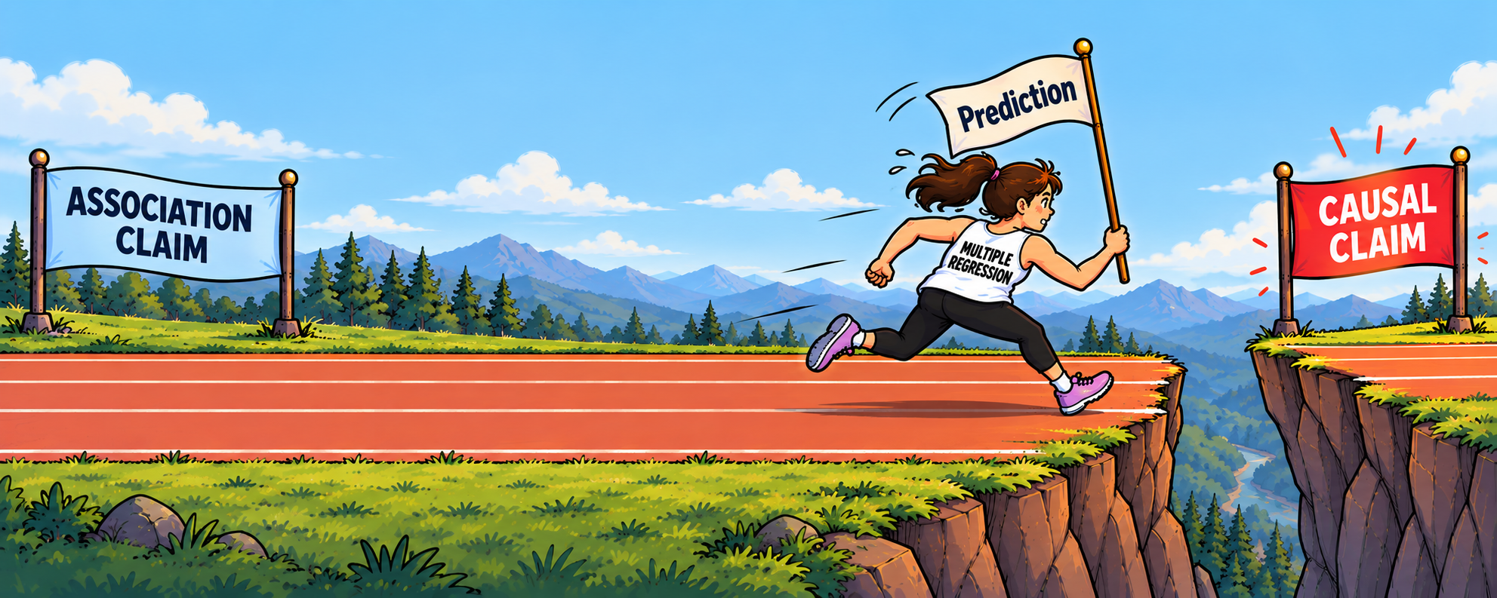
Regression and Third Variables
Regression looks at PREDICTION
Prediction ≠ Causation
  I CAN say ice cream sales predict sunburns
  I CANNOT say ice cream sales cause sunburns

Slide 21
Handling Third Variables
In correlational/ regression research, we are only measuring the variables we GUESSED might impact the outcome variable, not all possible third variables
If we can’t know all possible third variables, we need a way to eliminate them without knowing what they are
AKA… we need randomization (so each group should have an equal chance of the third variable in both groups, so the third variable is cancelled out)
To have random assignment to a condition, we need an experiment

Slide 22
Handling Third Variables
So, what if random assignment isn’t available? (For example, if it’s impossible or unethical to force someone into a group)
Answer: we use the rule of parsimony to get as close as we can
Parsimony – the simplest explanation is the best explanation
In action, we evaluate as many predictions related to the same theory as possible, so that the only shared answer is the most likely cause

Slide 23
Handling Third Variables
Consider the scenario where we want to know if long-term cigarette use causing lung cancer
We separately (and repeatedly, if possible) test each of these predictions:
  The longer a person has smoked cigarettes, the greater are the chances of getting cancer.
  People who stop smoking have lower cancer rates than people who continue smoking.
  Smokers’ cancers tend to be in the lungs and of a particular type.
  Smokers who use filtered cigarettes have a somewhat lower rate of cancer than smokers of unfiltered cigarettes.
  People who live with smokers will also have higher rates of cancer because of their passive exposure to the same chemicals.
By the rule of parsimony, if we can narrow it down to just the theory that smoking causes lung cancer, we can treat it similar to a causal claim
  As a reminder, theory ≠ law

Slide 24
Pattern, Parsimony, and Popular Media
Journalists do not always fairly represent pattern and parsimony.
When journalists report only one study at a time, they are selectively presenting only part of the scientific process.

Slide 25
Mediation and Moderation

Slide 26
Mediation and Moderation
If you want to know more information about your third variables, you can test if it is a mediator or a moderator
  You can do these with correlational research or experimental research
Mediation – A proposed explanation for a relationship, where a third variable is potentially driving the relationship between X and Y
  Tests why or how X and Y are related
Moderation – Explains how a third variable is altering the strength or direction of the relationship
  Tests when or for whom X and Y are related

Slide 27
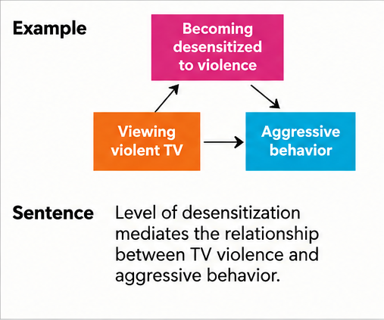
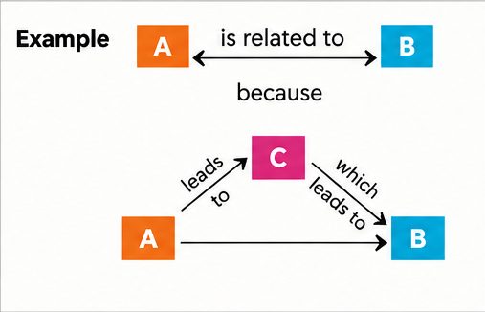
Mediation
Mediation: why are two variables related?

Slide 28
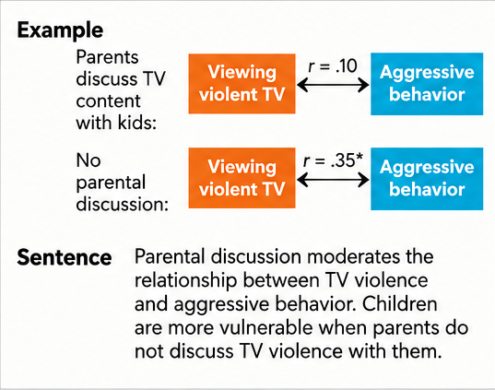
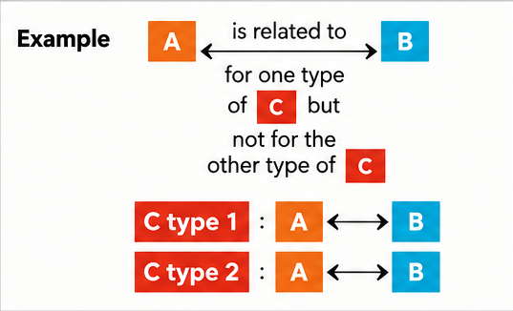
Moderation
Moderation: Are there certain groups or situations for which the two variables are more strongly related?

Slide 29
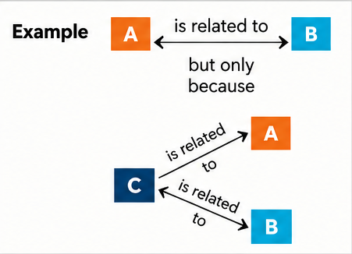
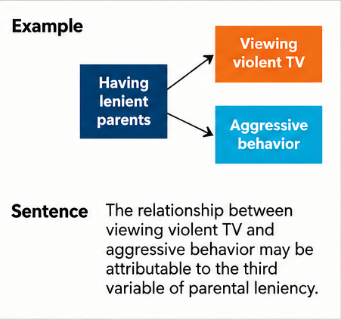
The Third Variable Problem
Things get “weird” because we are not rid of the third variable problem, even though mediation is relying on some level of causation
For mediation in regression research, we have to acknowledge that we might see a relationship, but another explanation could explain the causal aspect (thus, experiments that manipulate the mediator can make much stronger causal claims)

Slide 30
The Big 4 Validities in Multivariate Correlational Research

Slide 31
The Big Four Validities
Scenario: Evaluating the ability of relationship drama and degree program difficulty to predict student stress?
We’ve already discussed internal validity (a LOT), but what could we look at to evaluate…
Construct validity?
Statistical validity?
External validity?

